Slide 1
STATE OF TEXAS v TONY COX

Slide 2
RELATED TO?

Slide 4
UNLAWFUL RESTRAINT NOT ASSAULT FV

Slide 5
UNLAWFUL RESTRAINT
“A person commits an offense if he intentionally or knowingly restrains another person.”
Tex. Pen. Code 20.02

Slide 6
INTENTIONALLY
A person acts intentionally, or with intent, when it is his conscious objective or desire to engage in the conduct or cause the result.
Tex. Pen. Code 6.03

Slide 7
KNOWINGLY
A person acts knowingly, or with knowledge, when:
(1) he is aware of the nature of his conduct or that the circumstances exist, and
(2) he is aware that his conduct is reasonably certain to cause the result.
Tex. Pen. Code 6.03

Slide 8
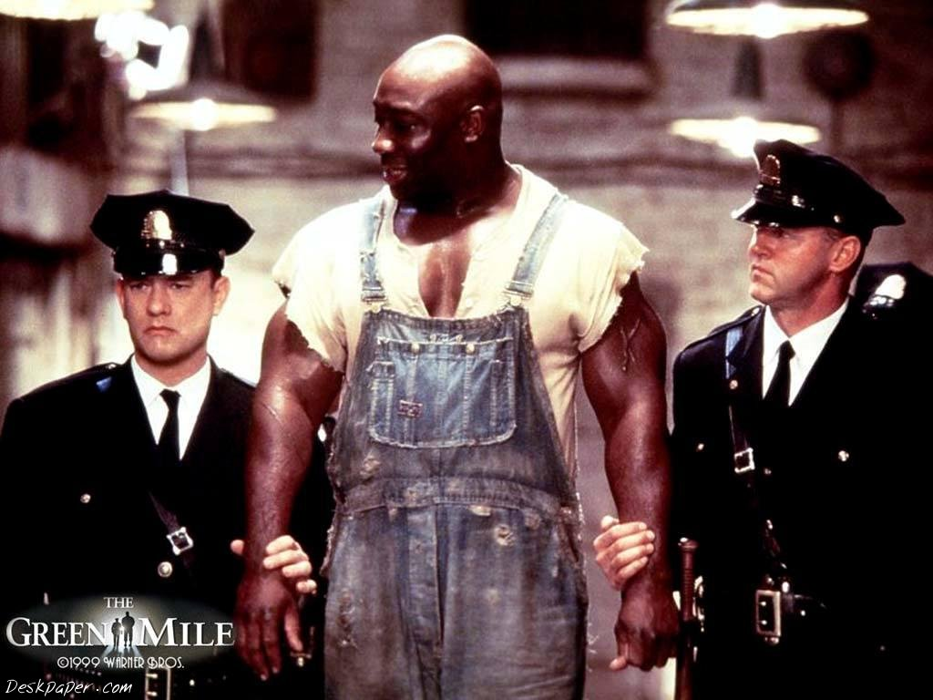
PLIGHT OF THE BIG MAN

Slide 9
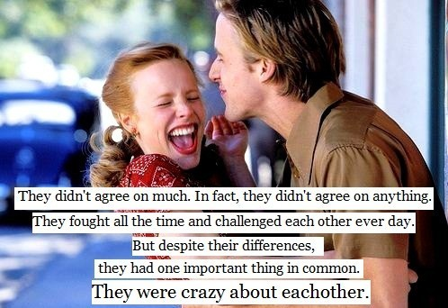
PASSIONATE RELATIONSHIPS

Slide 10
PASSIONATE RELATIONSHIPS

Slide 11
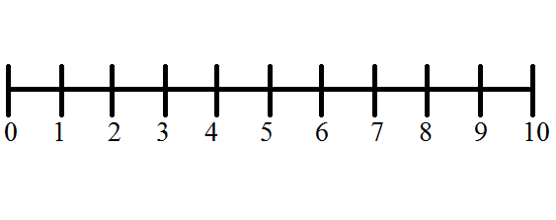
PRESUMPTION OF INNOCENCE
INNOCENT GUILTY

Slide 13
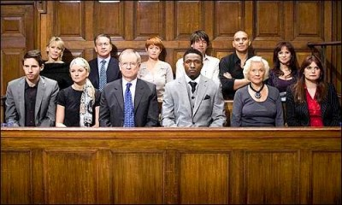
JURY SERVICE

Slide 14
THANK YOU

